Slide 1
Proposal, Planning and Presentation
Mary Margaret C. Nunez
BSBA NC 3-1

Slide 2

Proposal
pro·pos·al
/prəˈpōzəl/
a plan or suggestion, especially a formal or written one, put forward for consideration or discussion by others.

Slide 3
Companies prepare business proposals for several purposes, including arranging financing, responding to tenders and planning business partnerships. A business proposal may be in the form of a written document, a slide (PowerPoint) presentation or a combination of both. A good proposal presentation could be the key to long-term financial success for a small-business owner.

Slide 4
Financing and Partnership Proposals
Financing proposals include applications for bank loans and venture capital funding. Lenders want to know that you can make the monthly payments, and venture capital investors look for management expertise. Use realistic scenarios when making cash flow projections.
For example, do not base on your projections on achieving a 50 percent market penetration in the first year, because it is unrealistic. Outline the risks of your proposal, such as economic downturns and competitive pressures; and the consequences, such as lower cash flow.

Slide 5
Bid Proposals and Product Demonstrations
Businesses often respond to tenders from public or private contracting agencies by submitting proposals. Treat such presentations as job interviews. The customer has read your written submission and now wants to meet you to decide if he can do business with you. Allow plenty of time for questions.
For example, if you have 45 minutes to meet, use 10 to 15 minutes for your presentation and set aside the rest for the customer to ask questions. If you are doing a product demonstration, prepare a video demonstration or some other backup, because technical malfunctions do occur, and you can't afford such a circumstance.

Slide 6
Proposal Presentation Tips
Business proposal presentations usually include a slide presentation and a proposal document. The two should complement and reinforce one another. The slide presentation should highlight the key points in the proposal document. Use a simple slide layout, and do not include more than three or four key points per slide.
Select one or two qualified senior executives or employees to make the presentation, with others available for question-and-answer sessions. Research the audience background and the room layout. Do a few dry runs of the presentation to get the timing right.

Slide 7
Tips
Prepare a one-page summary with the key points of your proposal: what your business can do and why you're the ones to do it. Your audience will appreciate a quick-and-easy reminder of the details.

Slide 8
1. Understand the customer
2. Lay the groundwork
3. Focus on the 'how'
4. Don't over-promise
5. Validate your claims
6. Identify decision makers
7. Be confident
8. Be fair in pricing
9. Don't forget about design
10. Remember to proofread

Slide 9
PLANNING
plan·ning
/ˈplaniNG/
the process of
making plans for something.

Slide 10
Planning is essential to the success of any business. When a company has a plan to follow, leaders are better equipped to prepare for the future. A business plan creates a focus for the company, uniting employees toward common goals. When everyone works together, it’s easier to manage time and resources, to position the company for growth.

Slide 11
The main advantages of planning are as follows: To set directio
n
Planning increases the efficiency of an organization.
It reduces the risks involved in modern business activities.
It facilitates proper coordination within an organization.
It aids in organizing all available resources.
It gives a right direction to the organization.
It is important to maintain good control.
It helps to achieve the objectives of the organization.
It motivates the personnel of an organization.
It encourages managers' creativity and innovation.
It also helps in decision-making.

Slide 12
1)To set direction and priorities
First and foremost, you need a strategy because it sets the direction and establishes priorities for your organization. It defines your organization’s view of success and prioritizes the activities that will make this view your reality. The strategy will help your people know what they should be working on, and what they should be working on first.
Without a clearly defined and articulated strategy, you may very well find that your priority initiatives—the ones that will drive the highest success are being given secondary treatment.

Slide 13
2) To get anyone on the same page:
If you find that you have departments working to achieve different aims, or going in different directions, you need a strategy.
Once you define your strategic direction, you can get operations, sales, marketing, administration, manufacturing, and all other departments moving together to achieve the organization’s goals.

Slide 14
3) To simplify decision making:
If your leadership team has trouble saying no to new ideas or potential initiatives, you need a strategy. Why? Your strategy will have already prioritized the activities necessary for success. Priorities make it easier to say no to distracting initiatives.

Slide 15
4) To drive alignment:
Many organizations have hard-working people putting their best efforts into areas that have little to no effect on strategic success. They’re essentially majoring in the minors—because their activities aren’t aligned with the priorities. Your strategy serves as the vehicle for answering the question, “How can we better align all our resources to maximize our strategic success?”

Slide 16
5) To communicate the message:
Once you recognize the need to plan, you now have the role of becoming the catalyst: for facilitating the buy-in and commitment of your leadership team and the rest of your organization. I’ve found that very few executives truly understand how to maximize their role in facilitating strategy. This chapter is focused on you, the leader of the organization, and on the vital role you play in facilitating strategy throughout your organization. Let’s get started.

Slide 17
PRESENTATION
pres·en·ta·tion
/ˌprezənˈtāSH(ə)n,ˌprēˌzenˈtāSH(ə)n/
the giving of something to someone, especially as part of a formal ceremony.

Slide 18
Regardless, of whether your Presentation is for a social group, the office, family meeting or even a school. Presentation etiquette should always be followed as it helps you in conveying your message to the audience in a desirable way.
No doubt, there is no misconception to this statement that “Presentations are boring”. However, on the other hand one just can’t deny this fact that if you will keep your listeners respectful of your Presentation and tuned in. Then, it becomes easier for you to put your best foot forward with effective communication skills.

Slide 19
PowerPoint Presentation Etiquette
One can easily transmit a good message through Presentation, if a presenter comply with all below mentioned points, which will tell you what exactly etiquette means in today’s, fast paced world where everyone is short of time:

Slide 20
Come Well Dressed
It is always recommended to be better appareled than your audience since it shows your respect. Thus, if none of your audience wears a tie, then after few minutes you can take off your jacket and roll up your sleeves to put your listeners at ease.

Slide 21


Slide 22

Never Be Late
If you make your audience wait for even 3 minutes, then it just clearly shows that you are not given them due respect. When they are capable enough showed up on time, then it’s your responsibility to come ahead of time after all you are a presenter. It is recommended to test your projector, device connection, lights, auditorium, speaker phones, as well as other devices before you start the presentation.

Slide 23

Be Prepared for an Uncertainty
In case, if you lose the zip drive your slideshow was saved on, then you must have a backup in the form of hard copy that you can distribute among spectators. Thus, it’s better to prepare yourself in advance for the uncertain circumstance.

Slide 24

Speak Clearly
If your audience won’t be able to listen to what you are trying to convey, they are sure to lose interest and so this tip plays a vital role in making or breaking up your Presentation. Therefore, speak slowly and not rapidly as it shows you have crammed a lot of stuff for your Presentation

Slide 25
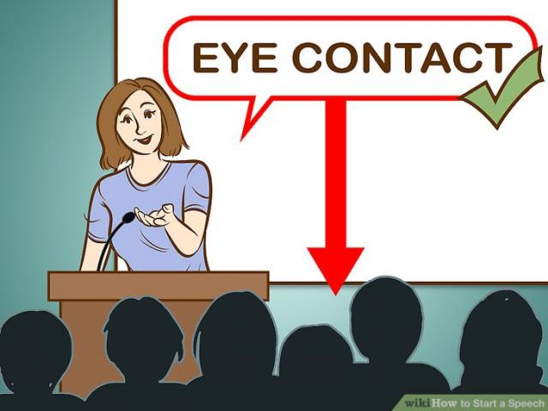
Eye Contact
If you sense that audience is not getting what you are saying, then do get feedback and make sure you look at your spectators not at screen. Only then, you would be able to do justice with your Presentation. At the end of talk, thank them twice!

